Slide 1
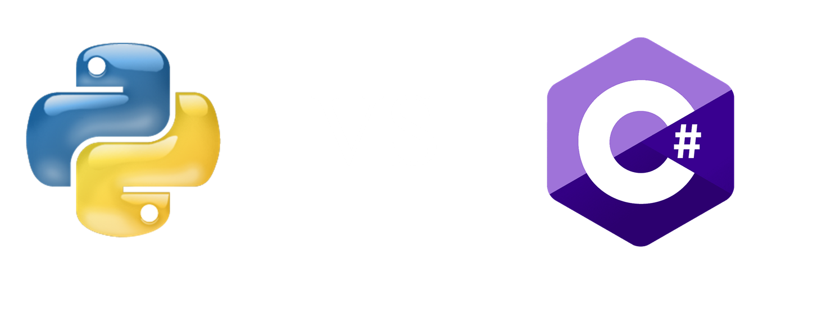
How many of you know at least one the two languages?

Slide 2
What fundamental differences in syntax, performance and suitability exist between C# and Python?

Slide 3
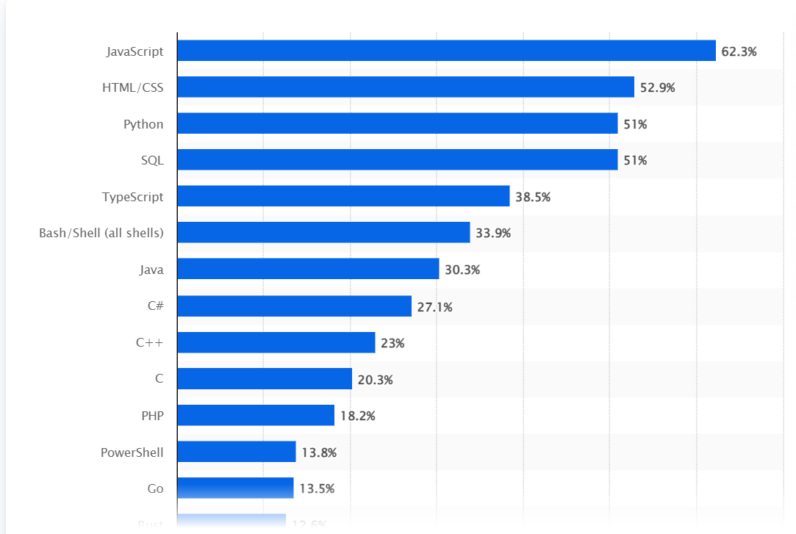
Most used programming languages among developers worldwide for 2024

Slide 4

Python - History
At first, it was a hobby project.
Guido van Rossum
December 1989

Slide 5
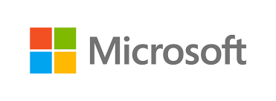
C# - History
Microsoft
2000
Designed to run the .NET framework

Slide 6
Syntax - Variables
variableName = value
type variableName = value;
x = 5
y = "John"
print(x)
print(y)
string name = "John";
Console.WriteLine(name);

Slide 7
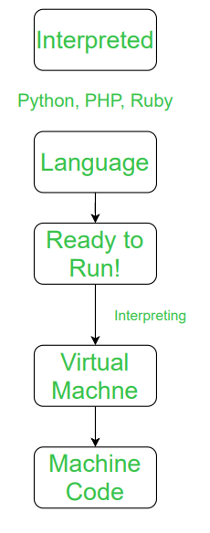
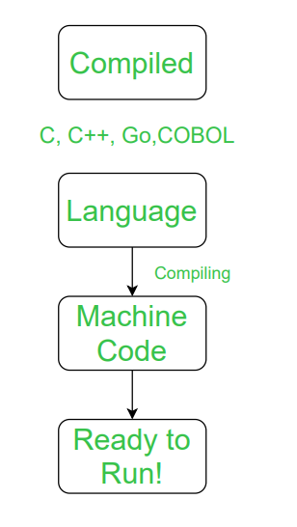
Performance

Slide 8

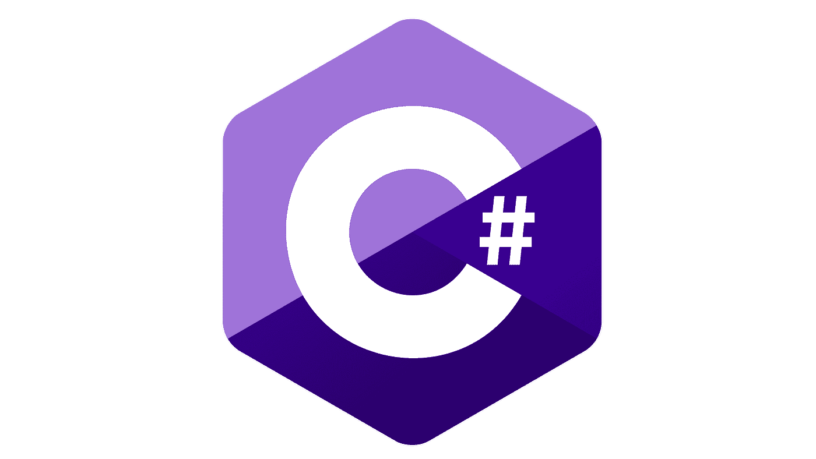
Suitability
Software development
Game development
Web development
Mobile applications
Web development
Machine learning
AI

